Slide 1
Weekly Report
Wangwon Lee, 2019/05/04
This week | Next week
Activation Maximization Apply AM to the other model Class Activation Map What is CAM Apply CAM to 1D model | Mapping the brain To study the brain AFNI RDM matrix Extract feature for mapping
Interesting and new finding
Visualization Class Activation Map (GradCAM)
The aim of this month / Discussion
The aim of this month: To study brain data.
Notes:
I want you to follow this rule

Slide 2
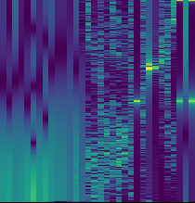
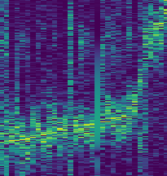
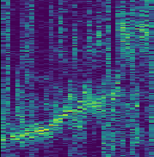
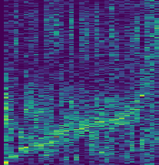
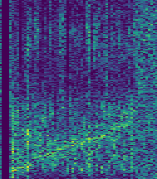
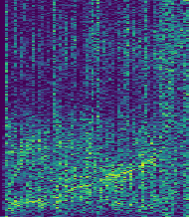
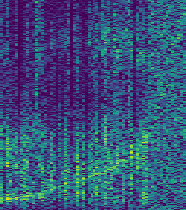
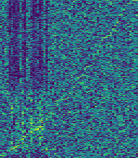
Previous Work – ch32 model
X axis: each filter (sorted by most highest frequency of each filer)
Y axis: frequency
< 1st layer >
< 2nd layer >
< 3rd layer >
< 4th layer >
< 5th layer >
< 6th layer >
< 7th layer >
< 8th layer >
- 2 -
Notes:
Supporting facts

Slide 3
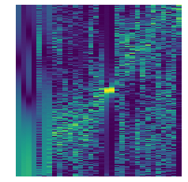
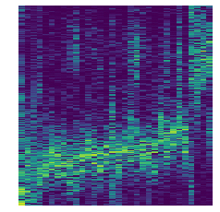
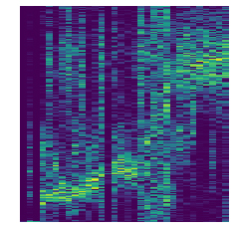
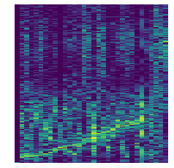
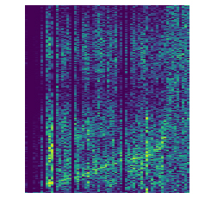
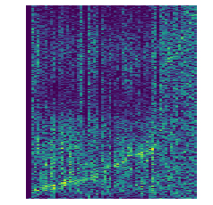
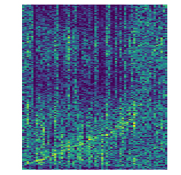
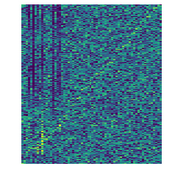
Activation Maximization – ch64 model
It is very similar to the previous results
< 1st layer >
< 2nd layer >
< 3rd layer >
< 4th layer >
< 5th layer >
< 6th layer >
< 7th layer >
< 8th layer >
- 3 -
Notes:
Supporting facts

Slide 4
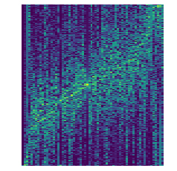
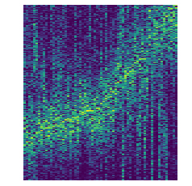
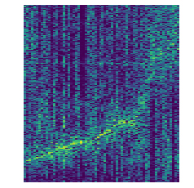
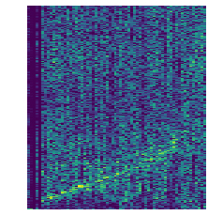
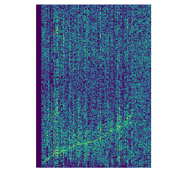
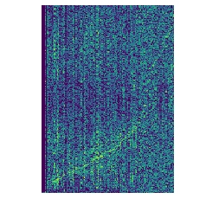
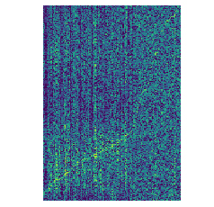
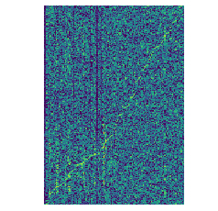
Activation Maximization – VGG like model
It is also very similar to the previous results
But I couldn’t why the result is noisy…
< 2nd layer >
< 4th layer >
< 6rd layer >
< 8th layer >
< 10th layer >
< 12th layer >
< 14th layer >
< 16th layer >
- 4 -
Notes:
Supporting facts

Slide 5
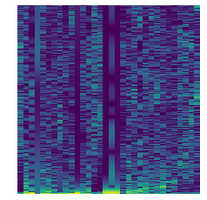
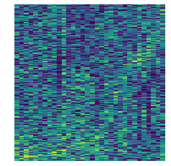
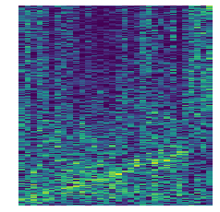
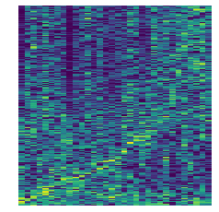
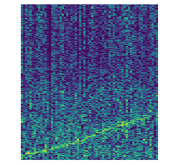
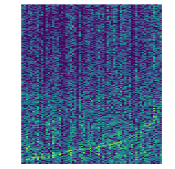
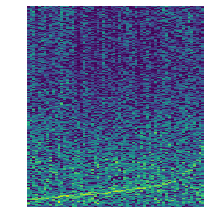
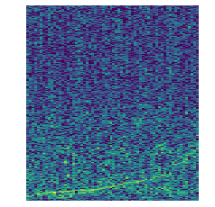
Activation Maximization – tanh model
X axis: each filter (sorted by most highest frequency of each filer)
Y axis: frequency
< 1st layer >
< 2nd layer >
< 3rd layer >
< 4th layer >
< 5th layer >
< 6th layer >
< 7th layer >
< 8th layer >
- 5 -
Notes:
Supporting facts

Slide 6
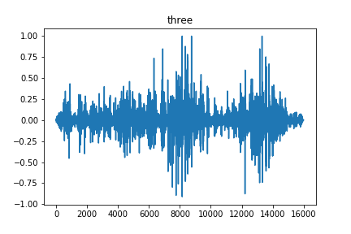
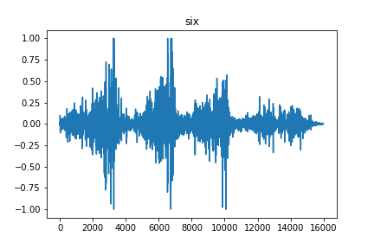
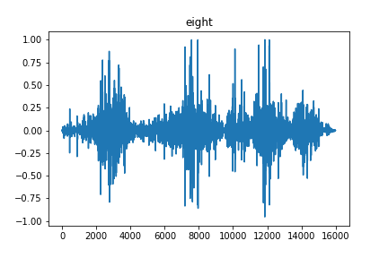

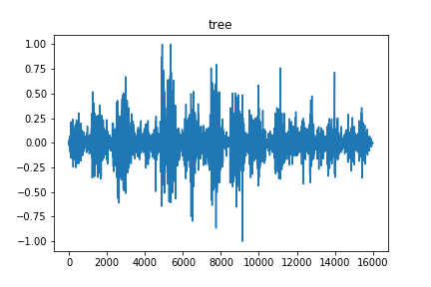
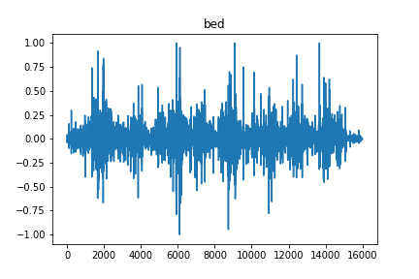
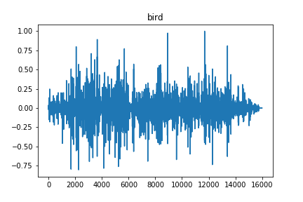

AM in 1D Model – output layer
It seems like real sound waveform
What if we listen that?
In last time…
- 6 -
Notes:
Supporting facts

Slide 7
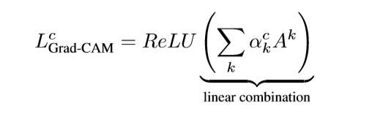
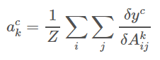
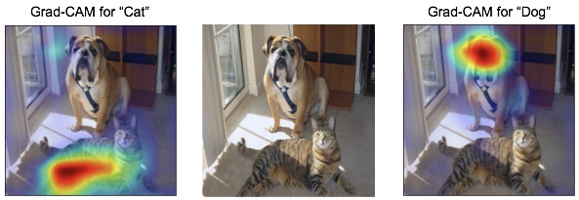
What is CAM(Class Activation Map)
Class Activation Map (also known as ‘attention map’).
The CAM visualizes where each class is focusing on.
Multiply the last convolution layer’s gradient and feature map
,
- 7 -
Notes:
Supporting facts

Slide 8
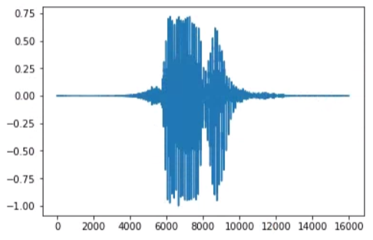
CAM – Apply 1D model
Importance
Of
Each class
Using
CAM
Highlighted
Result
- 8 -
Notes:
Supporting facts

Slide 9
CAM – Example “Zero”
The attention represent original data only for the corresponding class.
In corresponding class, the result focus on overall, But the other is not.
Input
CAM
applied result
Input
CAM
applied result
zero
eight
one
nine
two
bed
three
bird
four
cat
five
dog
six
tree
seven
house
- 9 -
Notes:
Supporting facts

Slide 10
CAM – Target attention
Make CAM for each class.
As I expected it, the most of result focus on overall input.
As the result, the model focus on unvoiced sound than voiced sound.
Zero
One
Three
Bed
Tree
- 10 -
Notes:
Supporting facts

Slide 11
Any Question?
Thank you
Notes:
Supporting facts

